Slide 1
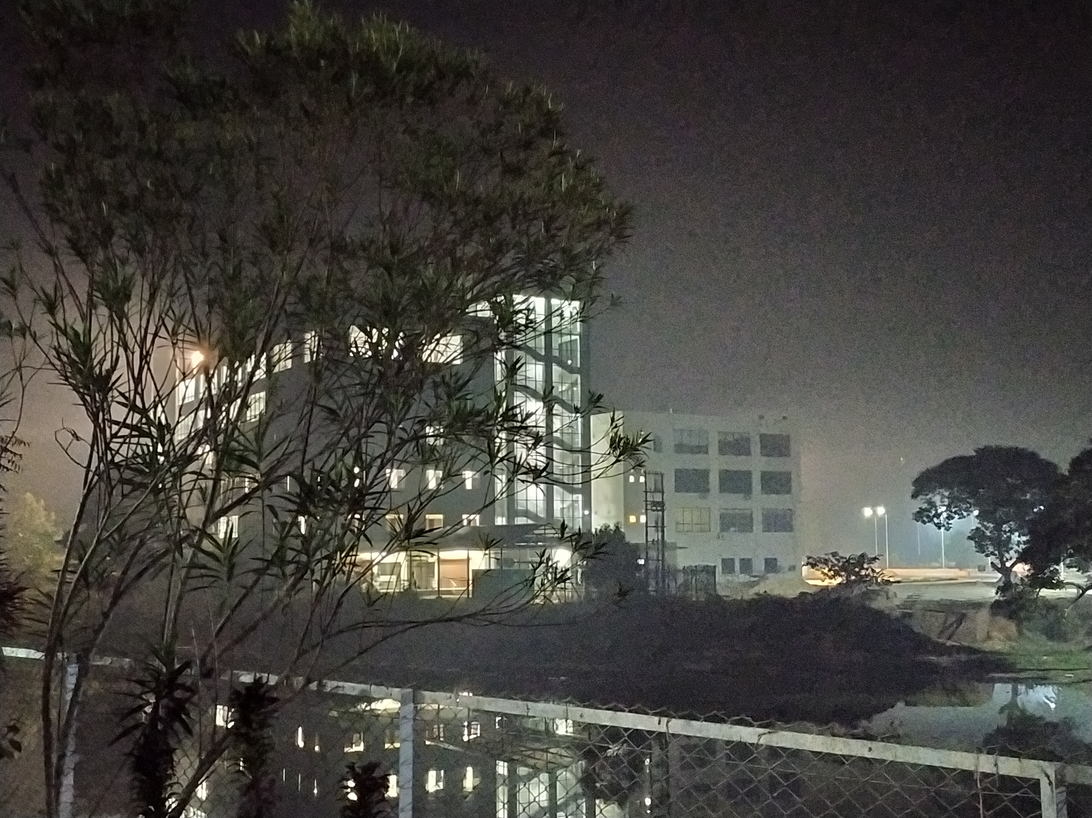
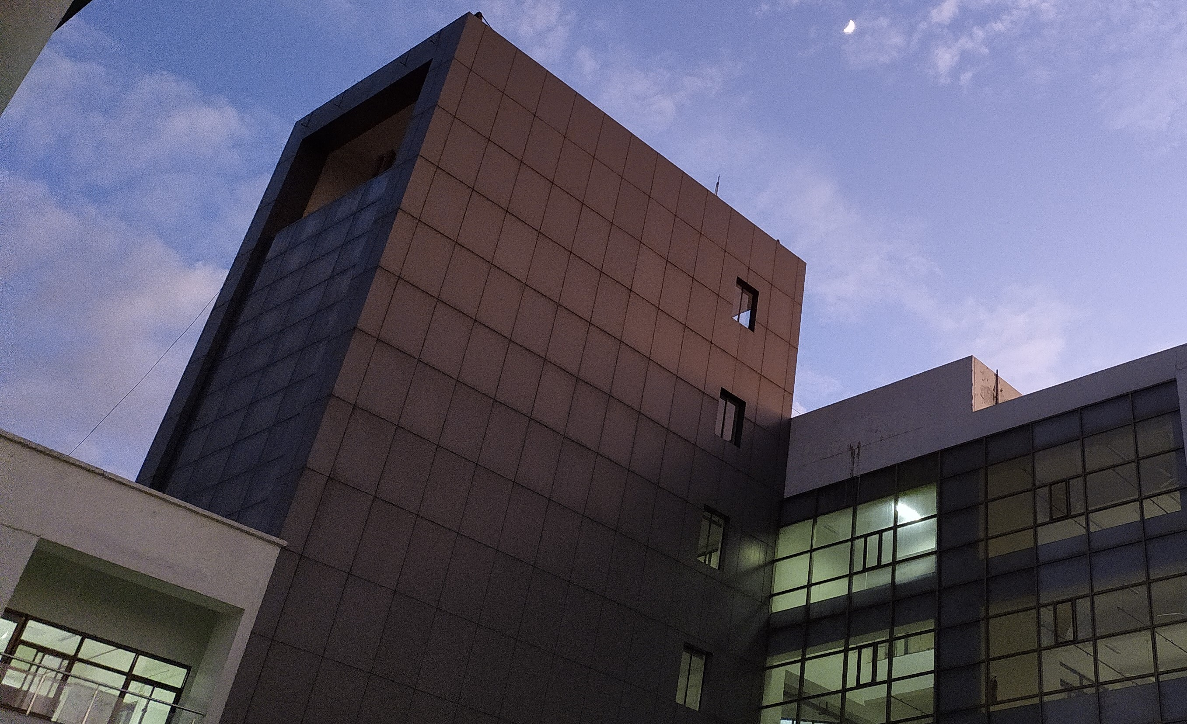
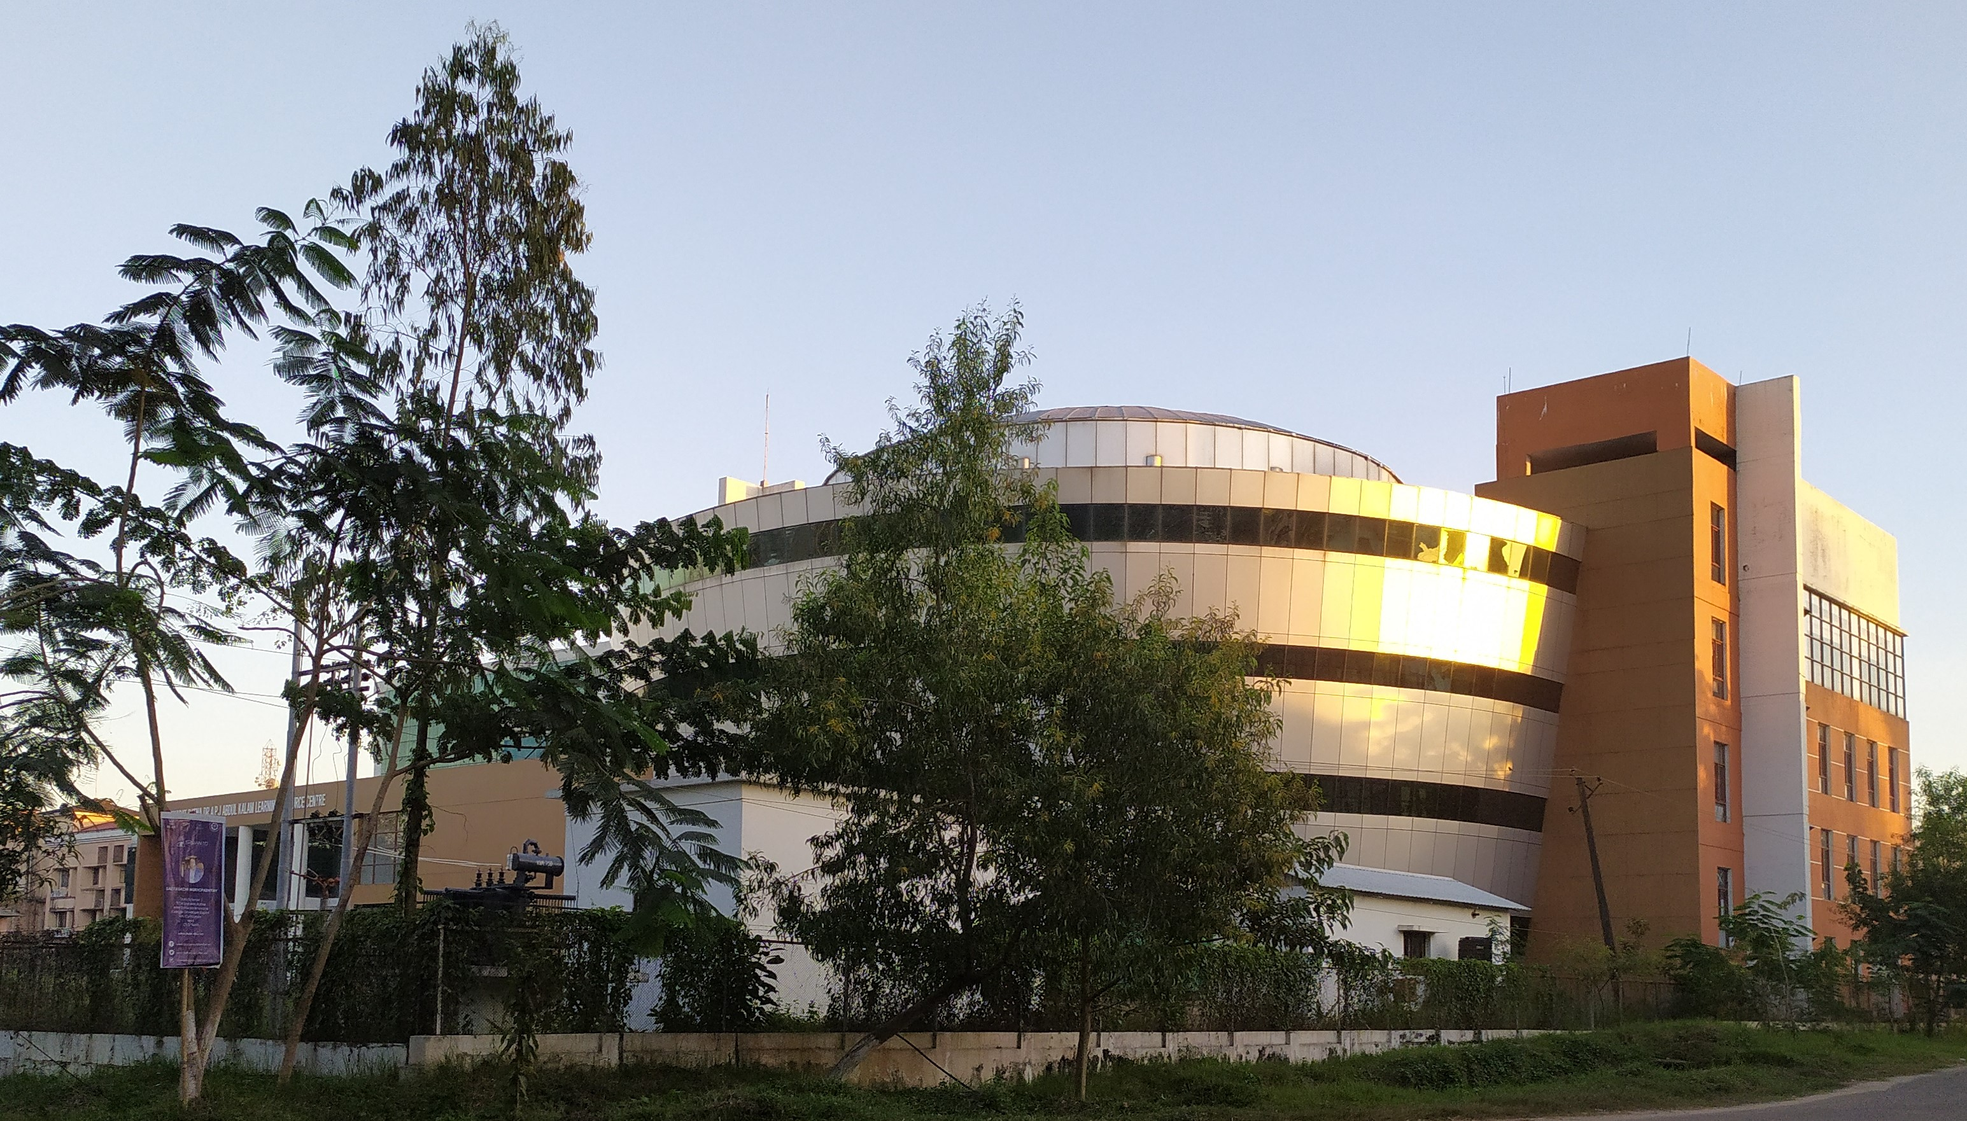




National Institute of Technology Silchar
ICRAME
2023
2nd Research Conclave
4th February 2023
Poster Presentation
Contact Us
Poster presentation template can be downloaded from the conference website
+91 8011886455
Registration Fees: Rs. 500/-
icrame2023@nits.ac.in
Department of Mechanical Engineering
National Institute of Technology Silchar
www.nits.ac.in
www.icrame.nits.ac.in

